Slide 1
Week 4 Assignment MSDS 670 Data Visualization
Kaytie Moyer
Regis University
September 18, 2021

Slide 2
Summary
The Week 4 Project demonstrates results taken from data provided by the Exact Medical Health System Laboratory over a period of nine years from 2005 to 2014.
The medical data involved was used as a means of communication across several fronts of the medical field.
The information that results from analysis of the medical data helps hospitals and care facilities determine the most popular units and departments and where their resources should be allocated each fiscal year (Smith, 2008).
This project looked to answer the following research question; is the laboratory useful to the health system it is connected to?
The answer to this question could determine the allocation of resources to the laboratory from a business standpoint.

Slide 3
Data and Methodology
The data was sourced from John Koenig’s MSDS 670: Data Visualization class through the Course Resources. A link is provided in the references for personal viewing and use.
The original data included undefined categories and variables that were removed to unclutter the data set. Test values were standardized into either a Positive or Negative category for easier analysis. Each test was placed in a department category, based upon the type of test.
Cardiology – tests focusing on the heart and cardio system.
Exams – routine physical and mental examinations, physical pre-screenings, and surface examinations of oral, ocular and auditory senses.
Hematology and Immunology – blood and body fluid analysis, protein and lipid molecule profiles, and the testing of targeted molecule components.
Computed Tomography – mammograms, magnetic resonance imaging (MRI), X-Rays, and other computer based imagery and scanning.
Notes:
Cardiology examples – echocardiogram, ECG
Exams – mental health wellness exam, testicular screening
Hematology and Immunology – pap smears, STI testing, Basic metabolic panels which test for glucose presence
Computed Tomography – bone density scans, colonoscopies, MRIs

Slide 4
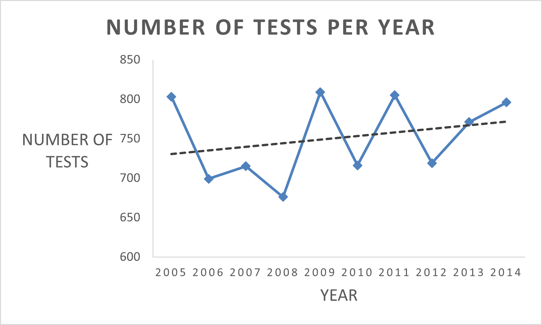
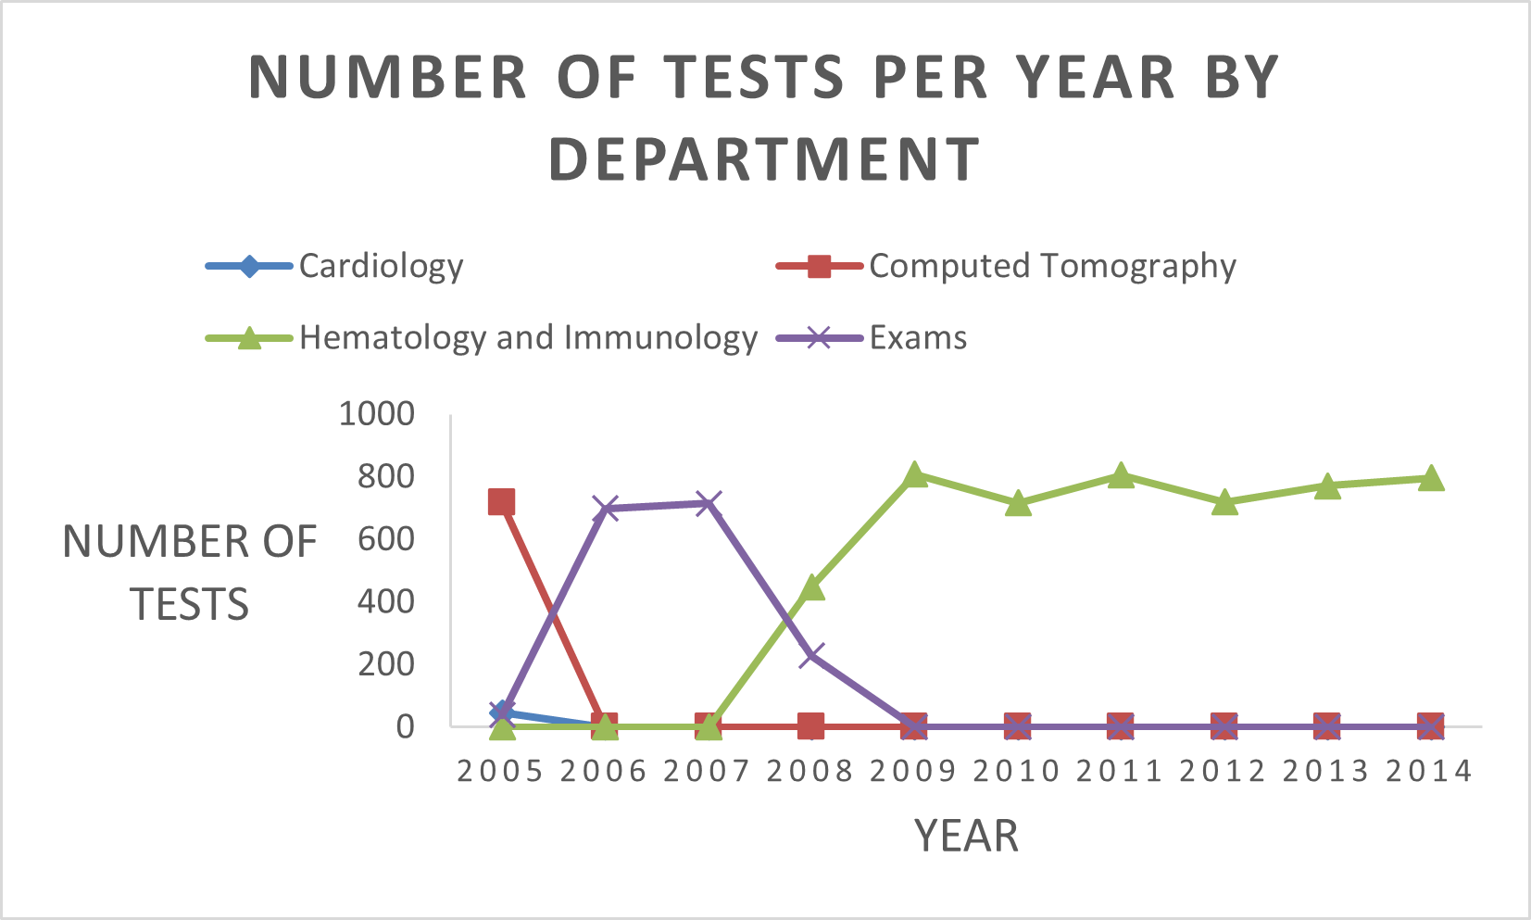
The number of tests per year dropped sharply from 2005 to 2006 with a slight increase in 2007 and later downturn in 2008, before seeing an overall increase from 2009 to 2014 for the entire laboratory.
The Hematology and Immunology department saw a sharp increase in testing numbers from 2007 to 2009 and remained at a steady overage until 2014.
The Computed Tomography department saw a sharp decline from 2005 to 2006 and remained at low numbers.
The Exams department saw an increase in testing from 2005 to 2006, remained steady until 2007, and then decreased through 2008 to 2009 where it remained at low numbers until 2014.
The Cardiology department remained at low numbers for the entire nine years.

Slide 5
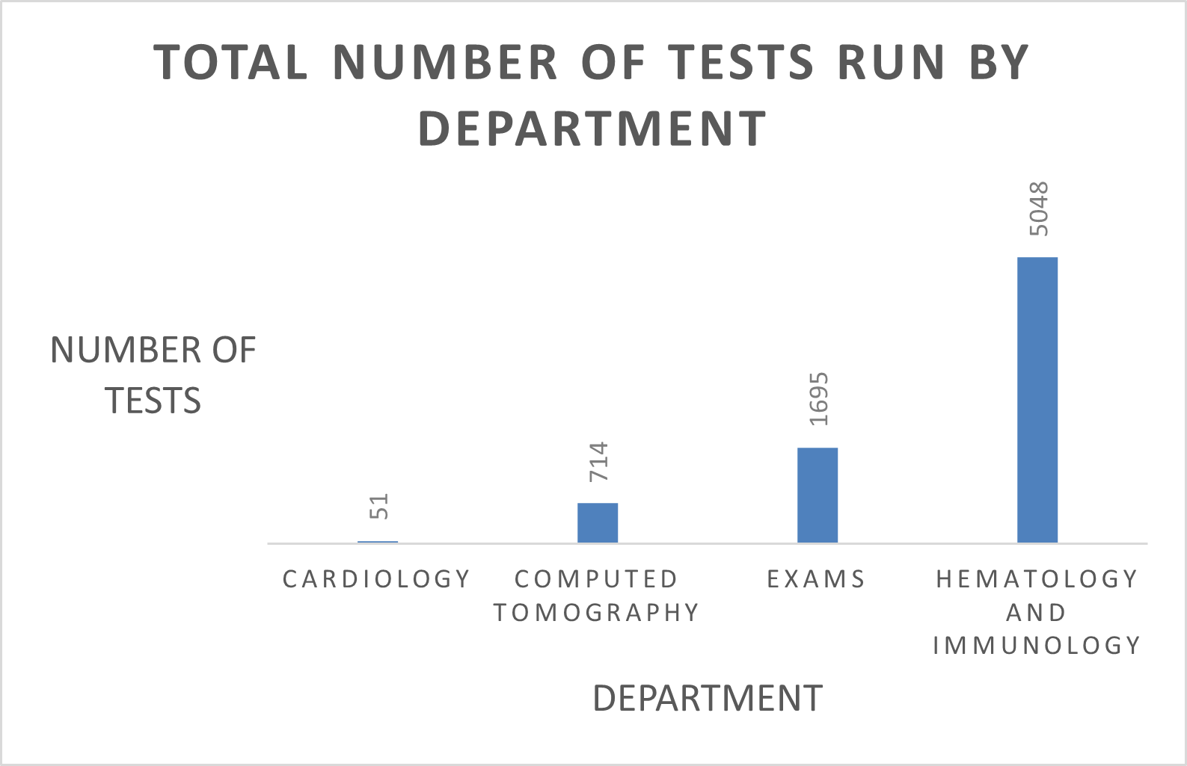
Over nine years, the Hematology and Immunology department ran the highest number of tests.
The Exams department ran the second highest number of tests, about 1/5 the amount of the Hematology and Immunology department’s results.
The Computed Tomography department ran the second lowest number of tests.
The Cardiology department ran the lowest number of tests in nine years.
Notes:
This should not be used as a determination of department productivity. Tests are not all performed the same and require different amounts of observation, equipment and manpower.

Slide 6
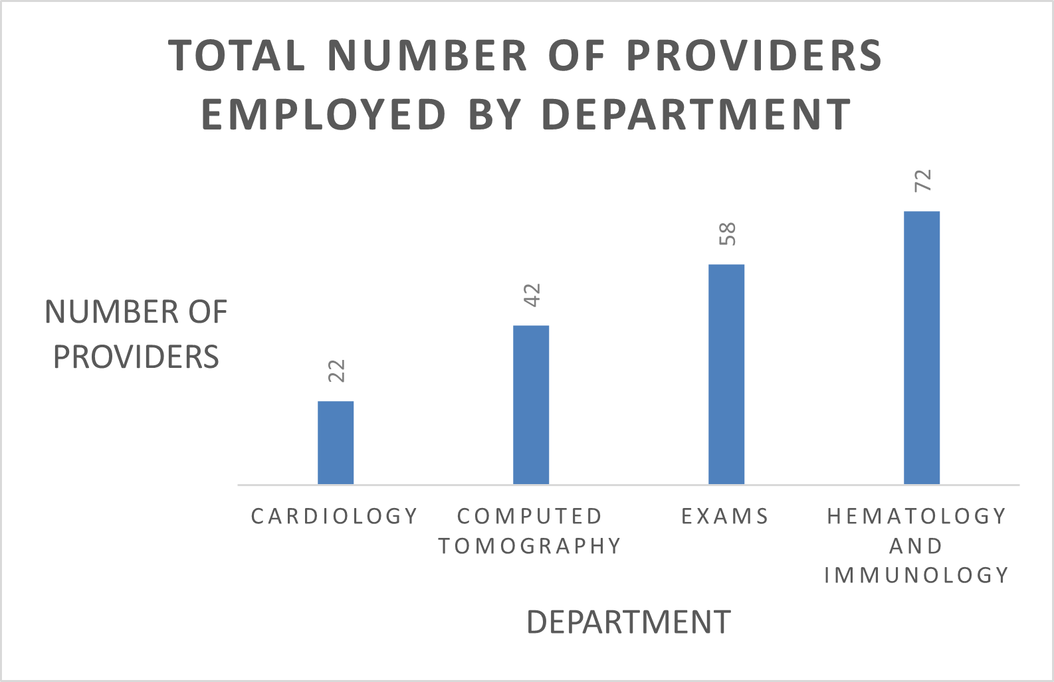
These results are a direct reflection of tests completed by department.
Hematology and Immunology employed the highest number of providers in nine years.
Each provider in Hematology and Immunology would have completed about 75 tests in the nine years of data.
By comparison, each provider in Cardiology would have completed about two tests in the nine-year period.
Notes:
Providers were counted once, even if they performed tests in multiple departments (multi-specialists).

Slide 7
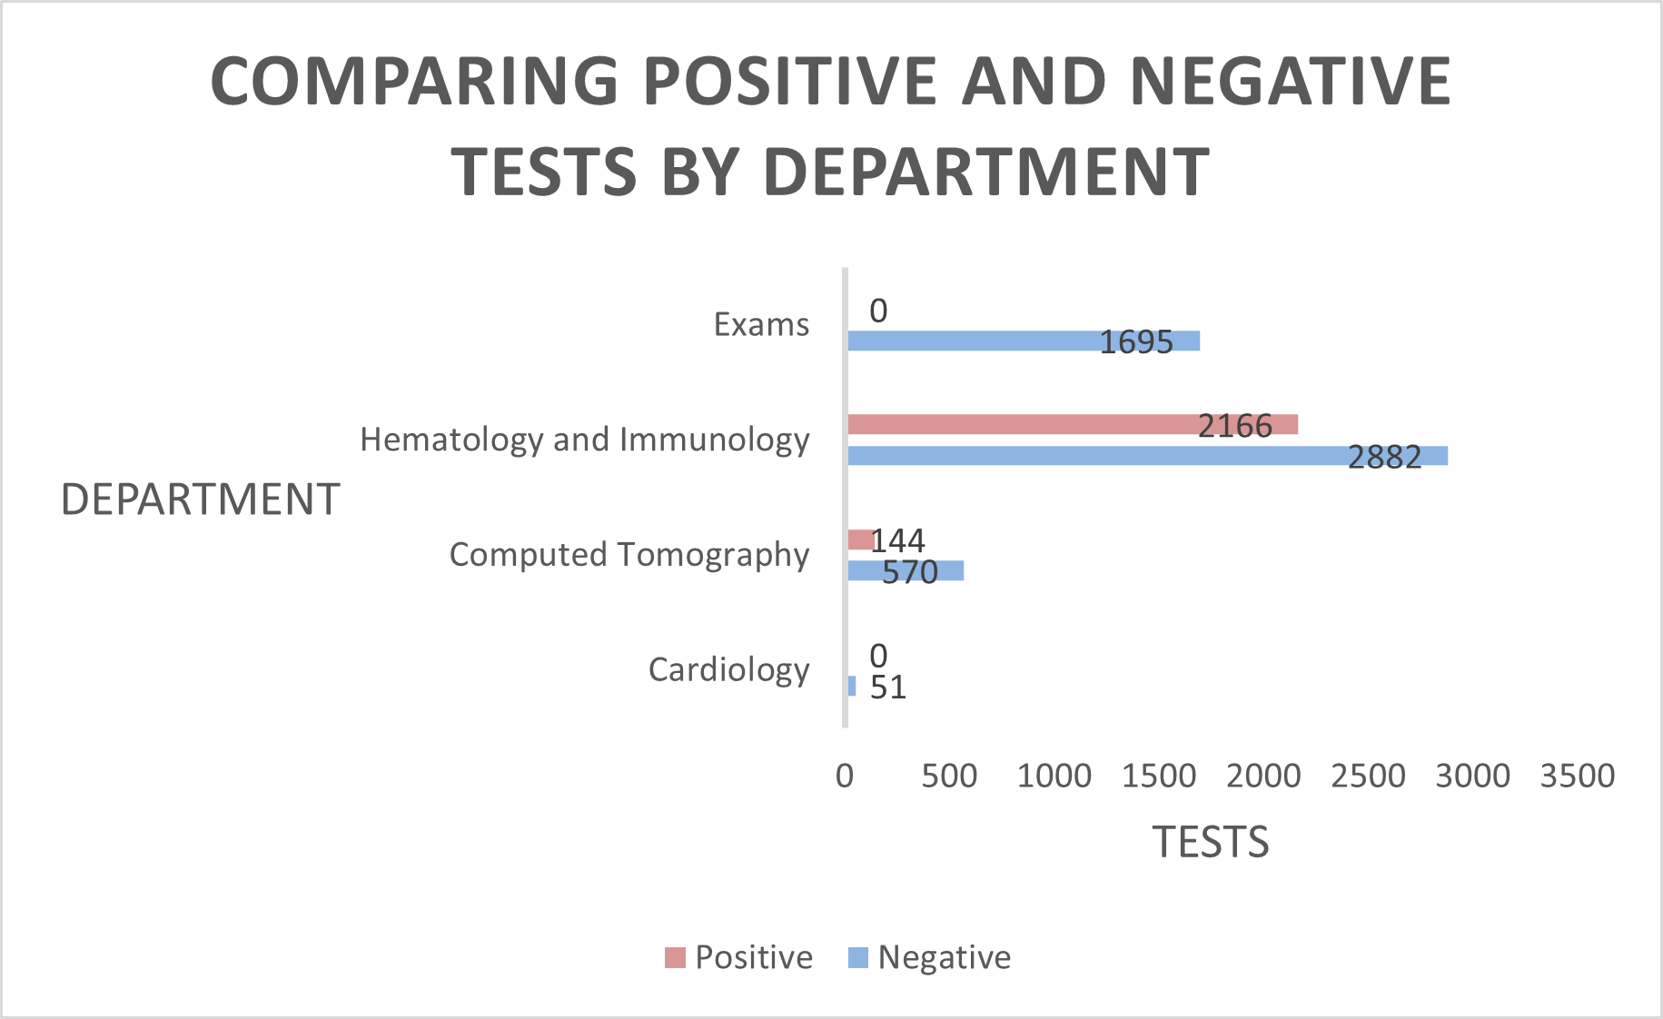
Hematology and Immunology had the largest ratio of positive to negative test results.
Exams and Cardiology both had no reports of positive test results.
Computed Tomography reported 144 positive results against 570 negative results, making it the smallest ratio of reported positives between the departments.

Slide 8
Conclusion
The Exact Medical Health system laboratory has seen increasing numbers of test completion. This means that the Laboratory is seeing higher numbers of tests being ordered compared to when the data was first taken in 2005 to when it was last taken in 2014.
The Hematology and Immunology department sees the highest number of tests compared to other departments, employing the highest number of providers and with the highest number of reported positive results, though this didn’t outnumber the number of negative results.
Future research should involve provider satisfaction surveys and questionnaires to ensure overworked employees and burnout is avoided in busier departments.
Additionally, further research into which test types have the highest rates of positive results versus negative results could help to determine why some departments report no positive results and other report higher positive results, versus the reason simply being because of the number of tests completed.
Finally, analysis should be conducted of what tests require to be completed to determine the true productivity of each department.

Slide 9
References
Smith P. C. (2008). Resource allocation and purchasing in the health sector: the English experience. Bulletin of the World Health Organization, 86(11), 884–888. https://doi.org/10.2471/blt.07.049528
https://drive.google.com/drive/folders/15Rg3HhRjkT3zyMgT5WBTEtvRHpPL95a4 (the location of the data set.

